Slide 1
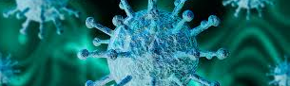
COVID-19 Response
March 17, 2020

Slide 2
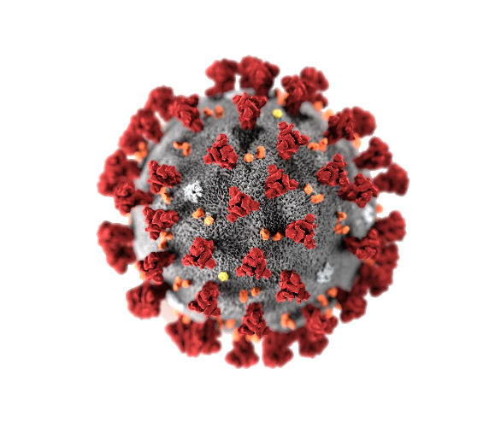
COVID-19 Business Statement
Continue business operations and keep employees as healthy as possible and employed throughout this crisis
Please don’t panic
Please do not trust or believe any news or media outlets as it could be misinformation
Everybody should focus on COVID-19 information directly from government sources for the most accurate and up to date news

Slide 3
COVID-19 Significant Events
WHO officially announced COVID-19 as a pandemic 3/10/20
President Trump issued international travel restrictions
Governor DeWine closed K-12 schools until April 6th
Governor DeWine closed all Ohio restaurants and bars and restricted to takeout or pickup only
Governor DeWine banned mass gatherings of 50 or more
Colleges/universities proceeding with online courses only, multiple campuses closed
Governor DeWine closed gyms, recreation centers, movie theaters and indoor parks
Citizens urged to stay home, avoid public areas, avoid public transportation

Slide 4
COVID-19 Education

Slide 5
COVID-19 Symptoms
The following symptoms may appear 2-14 days after exposure
Fever
Cough
Shortness of breath

Slide 6
Preventing COVID-19

Slide 7
NOSHOK’s Current COVID-19 Response
Any health and safety concerns or time off related to COVID-19, see Chris Cole directly
Any employment challenges related to government announcements such as child care related to COVID-19, see Chris Cole directly
All vacation and personal time requests suspended until 4/6/20
All previously approved vacation and personal time through 4/6/20 is revoked
Implement increased workplace hygiene with a deep clean scheduled for this afternoon followed by daily cleaning
We are suspending all business travel until further notice
We are suspending all on-site meetings and visits until further notice
Casual jeans attire until further notice

Slide 8
Q & A

Slide 9
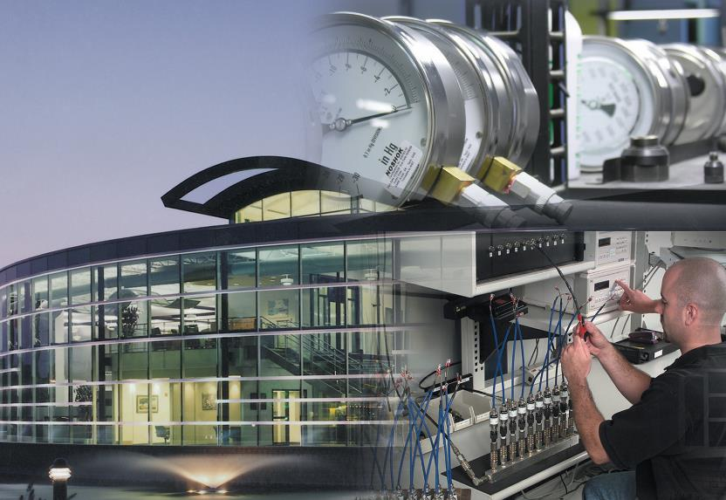
Measurement Solutions
NOSHOK Corporate Headquarters
1010 West Bagley Road, Berea, OH 44017
Ph: 440.243.0888 Fax: 440.243.3472
www.noshok.com

